Slide 1

An Exploratory Data Analysis Report on Public Transit Operations: Insights for MetroMove Transit Solutions
Presented by: Kuroyefa Leghemo

Slide 2
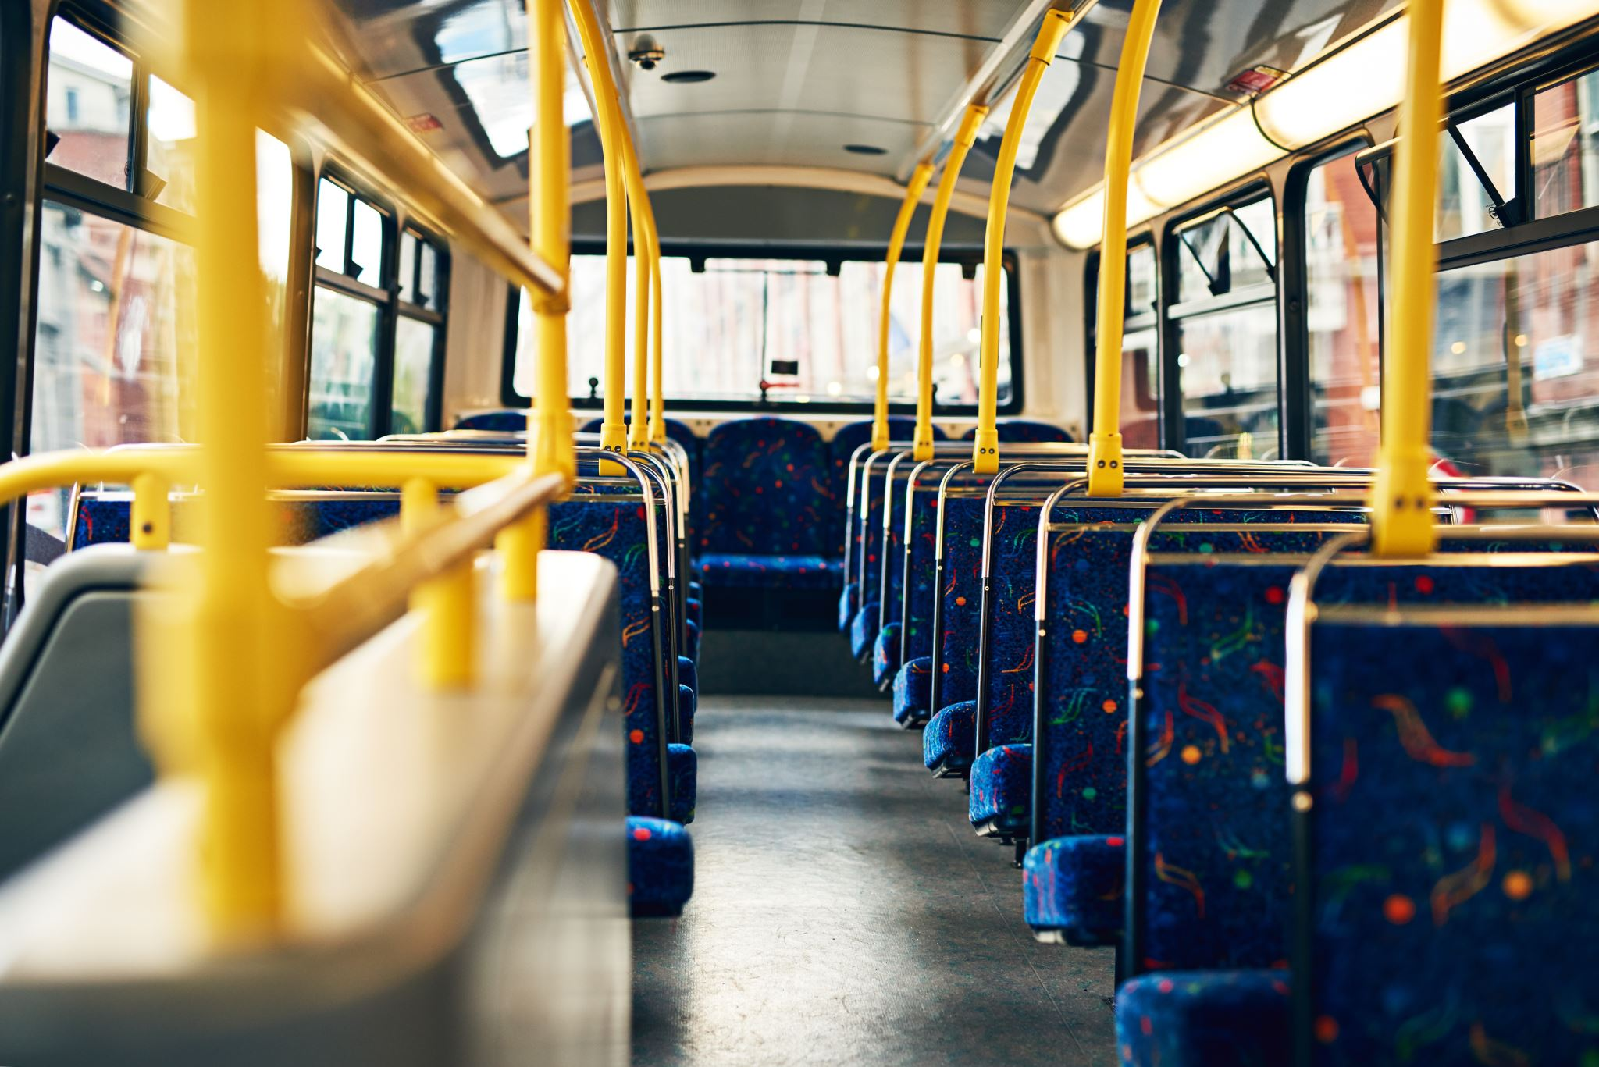
Introduction
MetroMove Transit Solutions operates across multiple cities
Manage thousands of daily trips via buses, trains, ferries, and trams
Focus on delivering efficient, affordable, and data-driven transportation

Slide 3

Problem Statement
MetroMove has extensive trip data
Difficulty extracting meaningful insights due to poor data quality data including messy, inconsistent, and incomplete records
Limited ability to identify inefficiencies and improve operations

Slide 4
Objectives
Clean the dataset to ensure data quality
Analyze passenger usage patterns
Evaluate performance across transport modes
Perform descriptive statistics to summarize key metrics
Create visualizations that effectively communicate findings
Clear documentations of analysis and actionable recommendations

Slide 5
Data Description
The dataset was provided by 10alytics and comprises MetroMove daily trip records spanning a six weeks period (Jan - Feb 2024)
Consists of 1,000 rows and 12 columns
Key variables captured includes trip id, mode of transport, departure station, arrival station, departure time, passenger count, fare amount, trip duration, date, and day of the week
Tool was Python, leveraging Pandas, Matplotlib, Seaborn, and Missingno for data manipulation, EDA and visualization

Slide 6
Methodology
Data loading and EDA
The dataset was loaded into Python from an Excel source and initial profiling done to understand the data types, quality, structure and initial statistical summaries
Data cleaning and preprocessing
Poor data qualities including inconsistencies were standardized, whitespace errors removed, non-informative/useless fields dropped and new columns were created to enhance analysis
Missing data patterns were assessed and found to exhibit characteristics consistent with MAR mechanism, informing a grouped-based median imputation of missing values

Slide 7
Methodology
Exploratory analysis and visualization
Visualization techniques were used to uncover patterns in passenger behaviour, fare structure, and trip performance across transport modes and time variable
Statistical validation
Post-cleaning descriptive statistics was computed to establish accurate values for key operational metrics
Actionable Recommendation
Actionable Recommendations informed by findings was made to improve passenger experience and optimize operations

Slide 8
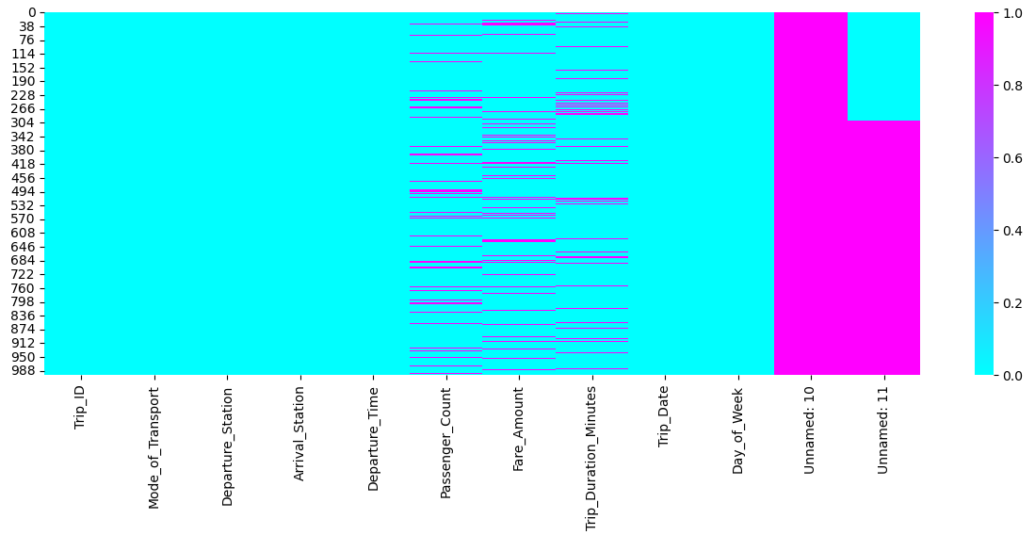
Results
Figure 1a: Heatmap of Dataset Before Data Cleaning
Notes:
Heatmap uncovered scattered but recurring pattern of missing values in passenger count, fare amount, and trip duration across records
Unnamed Column 10 completely missing throughout the dataset
Unnamed column 11 almost entirely missing throughout the dataset

Slide 9
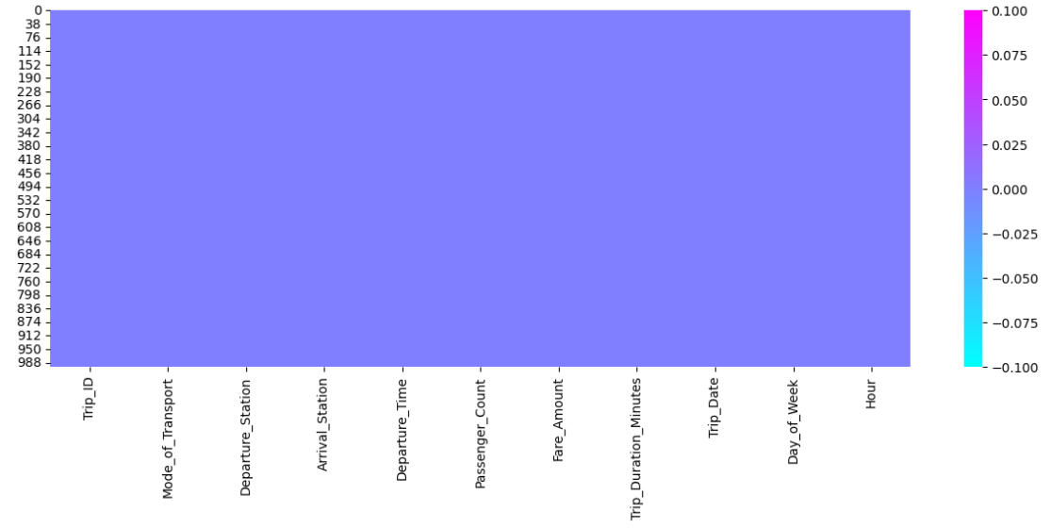
Results
Figure 1b: Heatmap After Data Cleaning
Notes:
Missing values successfully filled
Redundant columns dropped

Slide 10
Result
Key metrics:
Total trips 1000
Average passengers count 49.5
Average fare amount 25.4
Average trip duration 94.5

Slide 11
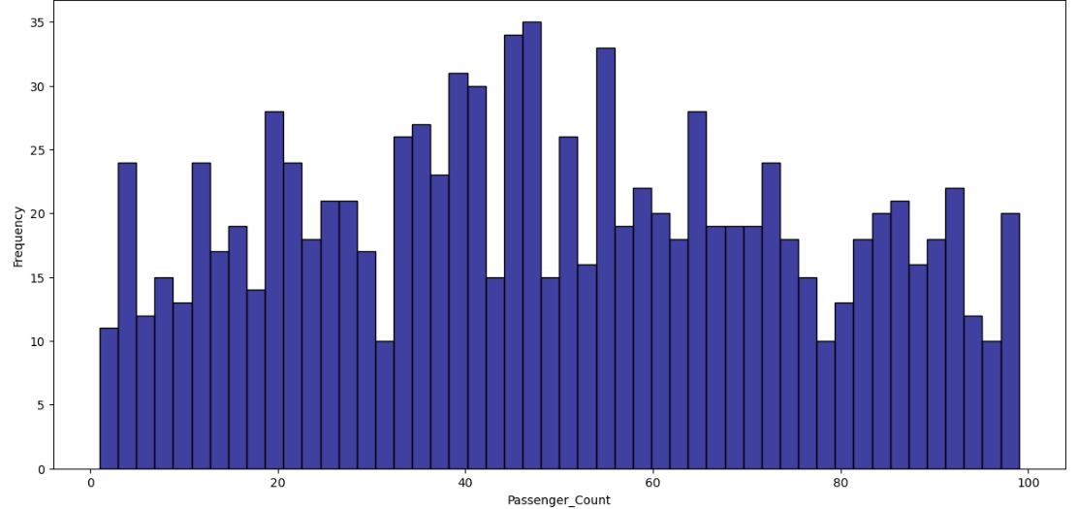
Result
Figure 2: The Total Distribution of Passengers Across All Trips
Notes:
Insights: Passenger counts are fairly distributed across a wide range, with most trips carrying a moderate to high number of passengers

Slide 12
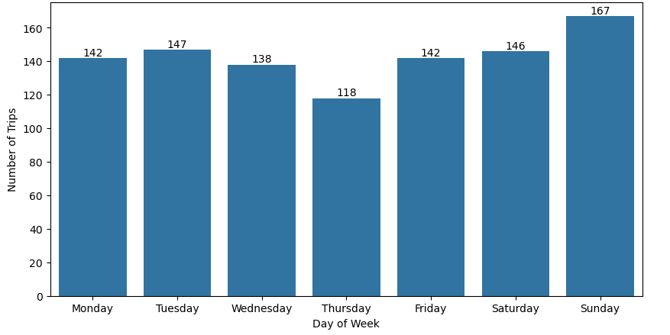
Result
Figure 3: Total Trips by Day of the Week
Notes:
Insight: Demand is lowest on Thursday but peaks sharply on Sunday, indicating a strong weekend usage pattern likely driven by leisure travel

Slide 13
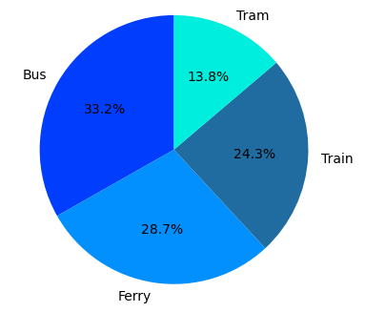
Results
Figure 4: Total Trips by Mode of Transport
Notes:
Insight: Bus is the most preferred mode of transport, with trams significantly underutilized compared to other options

Slide 14
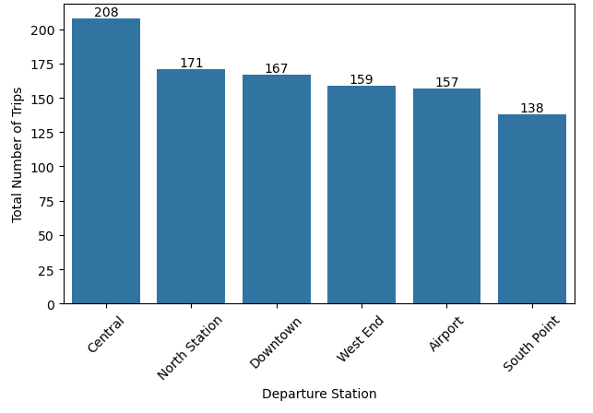
Results
Figure 5: Total Trips by Departure Station
Notes:
Insight: Trips are concentrated at Central station and then steadily decline across the other stations, with South Point having the fewest departures

Slide 15
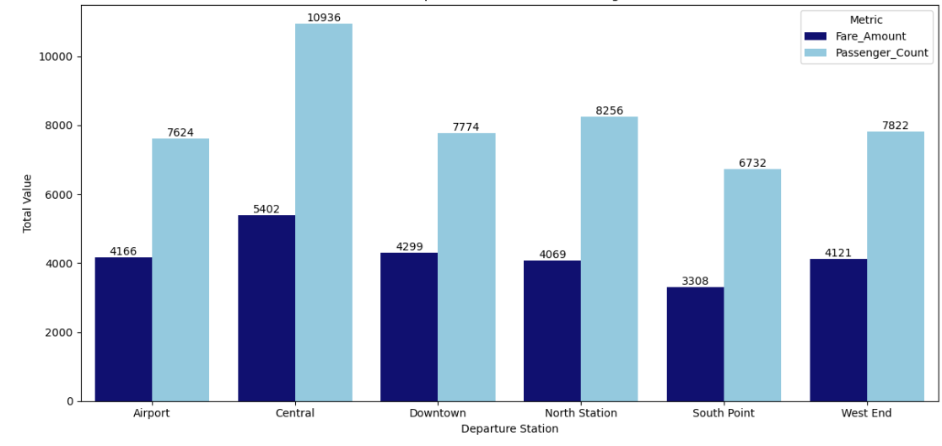
Results
Figure 6: Total Passengers And Total Revenue By Departure Station
Notes:
Insight: Central station handles the highest passenger volume and generates the most fare revenue, while South Point has the lowest activity across both metrics

Slide 16
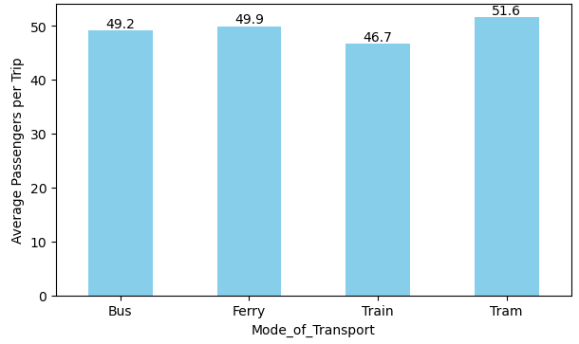
Results
Figure 7: Average Passengers Count Per Trip by Mode of Transport
Notes:
Insight: In comparison to typical transport capacity standards, buses align reasonably with expected usage, whereas trams, trains, and ferries show clear underutilization, highlighting opportunities to optimize service planning and demand alignment in the other modes of transport

Slide 17
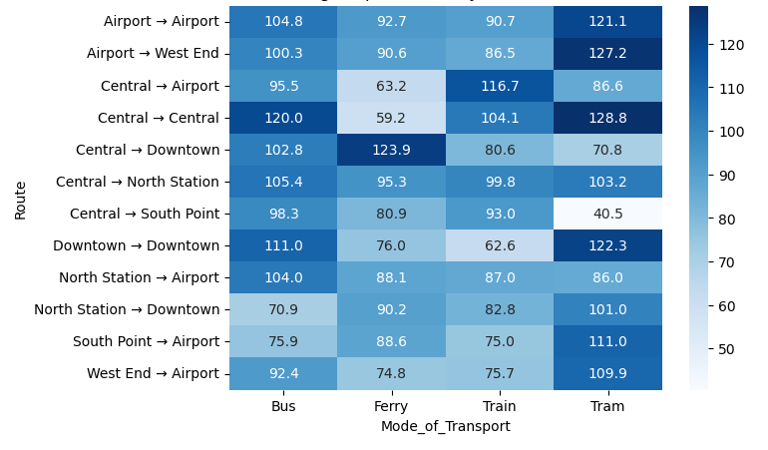
Results
Figure 8: Average Trip Duration by Route and Transport Mode (Performance Comparison)
Notes:
Insight: Compared to expected performance, where trains should generally be fastest, there were inconsistencies such that on several routes, slower modes like buses or ferries match or outperform trains—indicating potential inefficiencies in train operations or route design
E.g. Central → Airport by train (116 mins) is slower than bus (95 mins) and even tram (86 mins)
Central → Central by train (104 mins) is slower than ferry (59 mins)

Slide 18
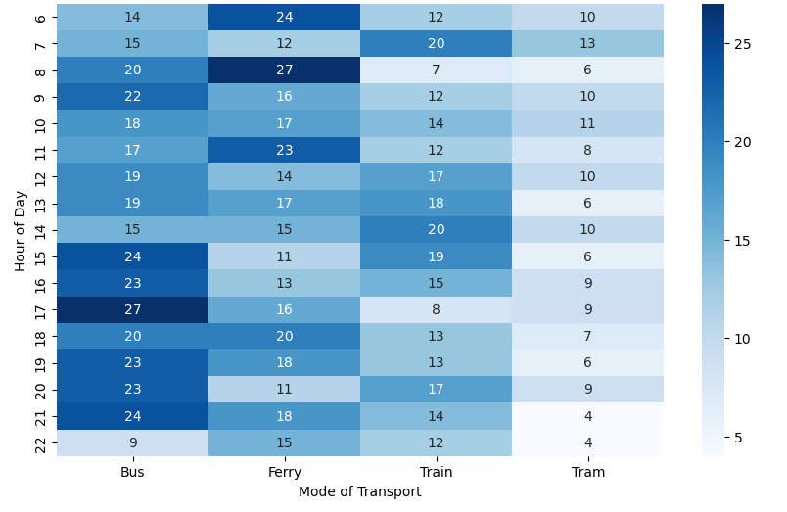
Results
Figure 9: Transport Demand by Mode and Hour of Day
Notes:
Insights: Peak demand is concentrated on buses in the afternoon/evening and ferries in the early morning, while trams are underutilized across all hours
Demand peaks are clearly time- and mode-specific
Buses peak in the late afternoon and evening (5 - 9 PM), ferries peak in the morning (8 AM), trains peak around early morning and early afternoon (7 AM and 2 PM), while trams utilization consistently declines with a modest peak at 7 AM

Slide 19
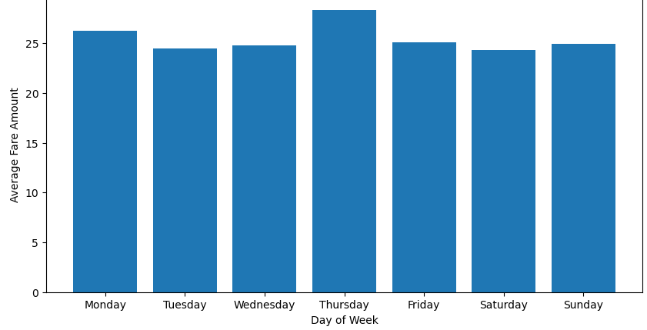
Results
Figure 10: Fare Amount by Day of Week
Notes:
Insight: Even though demand is lowest on Thursday, the highest revenue was generated on Thursday suggesting that fare patterns are being driven more by factors other than sheer demand

Slide 20
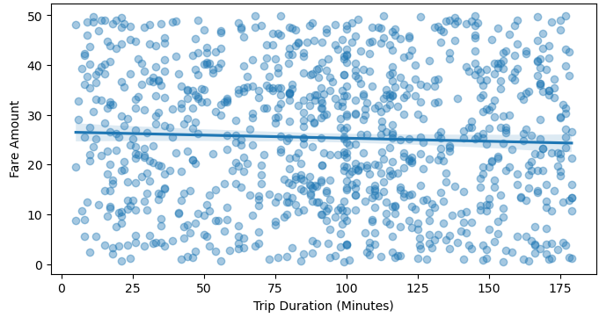
Results
Figure 11: Fare Amount by Trip duration in Minutes
Notes:
Insight: No relationship exist between fare amount and trip duration

Slide 21
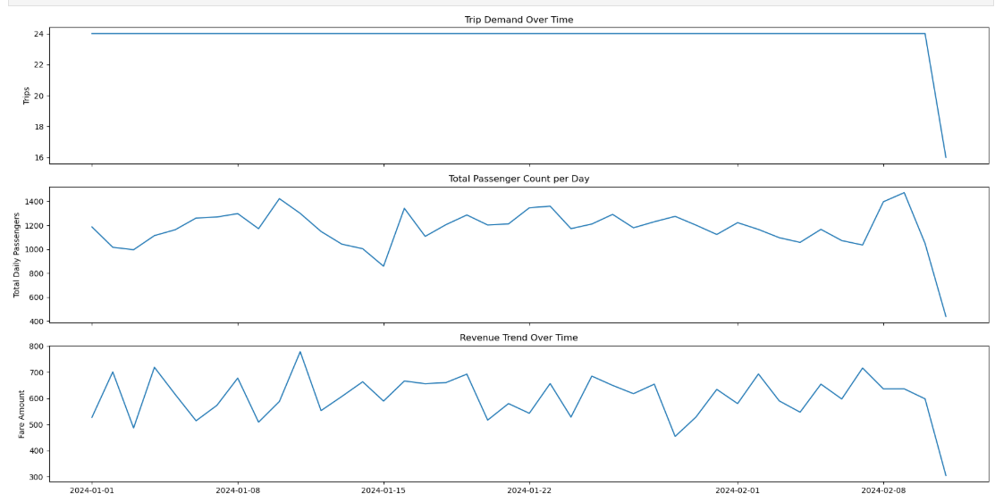
Results
Figure 12: Operational Performance Trends: Trips, Passengers, and Revenue Over Time
Notes:
Insight: Trip demand remained largely stable over time, while passenger volume and revenue fluctuate day-to-day with similar patterns

Slide 22
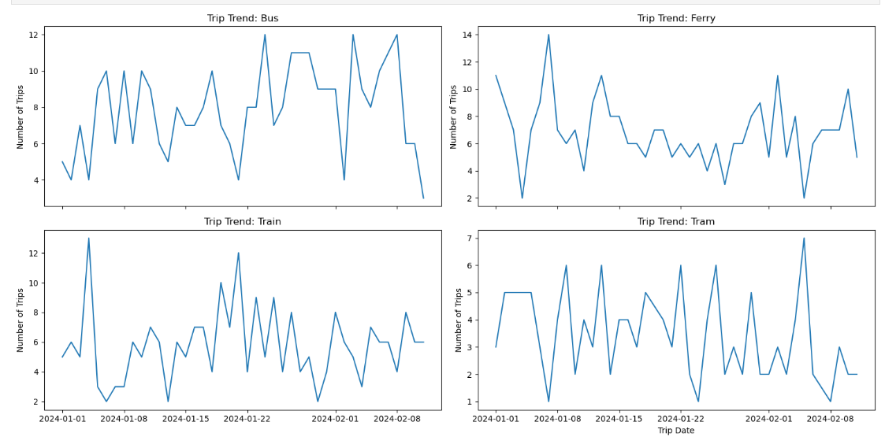
Result
Figure 12: Trends of Passenger Usage Pattern: Mode of Transport
Notes:
Insight: All mode of transport expressed volatility over time

Slide 23
Actionable Recommendations
1. Capacity & Scheduling
Increase bus capacity during late afternoon and evening (5–9 PM) to meet its peak demand
Optimize ferry scheduling around the 8 AM morning peak
Deploy more trains around 7 AM and 2 PM when demand spikes
Trim tram scheduling and use targeted incentives to address consistent underutilization across all hours
Use historical trip data to anticipate demand shifts and adjust service levels accordingly

Slide 24
Actionable Recommendations
2. Route Optimization
Investigate train operations on underperforming routes
Deploy trains only on routes where they hold a genuine speed advantage
Introduce express train services on routes where trains are currently slower than buses and trams to restore their expected speed advantage

Slide 25
Actionable Recommendations
3. Pricing & Demand
Align fares with demand especially on Thursdays with the lowest demand and highest revenue
Implement targeted interventions at South Point e.g. discounted fares or loyalty rewards to stimulate usage

Slide 26
Limitations
Short time window (only 6 weeks), which may not capture seasonal demand patterns
Small dataset (1,000 rows) limits the reliability of trends and generalizations across routes and modes
No external variables e.g. factors like weather, public holidays, or service disruptions were not captured, which could explain some demand fluctuations
No passenger demographics; analysis couldn't account for who is travelling (to target incentives more precisely e.g. student discounts, senior passes), limiting equity and targeting insights

Slide 27
Thank you

